Slide 1


ANALYZING INFLUENTIAL FACTORS IN BOSTON HOUSING: UNCOVERING PATTERNS AND DISPARITIES
Team Members :
Poornima Kolasani (AL79610)
Santosh Kumar Velgapuri (YS79974)
Neha Vunnam (BL60852)
Prof . Ergun Kacar

Slide 2
INTRODUCTION
Origin: Introduced in 1978 by Harrison, D., and Rubinfeld, D.L., this dataset has been a fundamental part of machine learning and statistical analysis.
Purpose: Created to understand the factors influencing housing prices in Boston suburbs.
Structure: Contains various attributes (features) that describe different aspects of suburbs in Boston, aiming to predict the median value of owner-occupied homes (MEDV).
Attributes: Includes diverse features such as zoning proportions, industrial areas, environmental factors like nitric oxides concentration, number of rooms, accessibility to highways, property tax rates, demographics, and more.

Slide 3
KEY FEATURES OF DATASET
Shape of the DataFrame : 506 Rows, 14 Columns
Attributes of Dataset are as follows:
ZN: proportion of residential land zoned for lots over 25,000 sq.ft.
INDUS: proportion of non-retail business acres per town
CHAS: Charles River dummy variable (= 1 if tract bounds river; 0 otherwise)
NOX: nitric oxides concentration (parts per 10 million)
RM: average number of rooms per dwelling
AGE: proportion of owner-occupied units built prior to 1940
DIS: weighted distances to ﬁve Boston employment centers
RAD: index of accessibility to radial highways
TAX: full-value property-tax rate per 10,000 dollars
PTRATIO: pupil-teacher ratio by town 12. B: 1000(Bk−0.63)2 where Bk is the proportion of blacks by town 13. LSTAT: percentage lower status of the population
MEDV: Median value of owner-occupied homes in $1000s

Slide 4


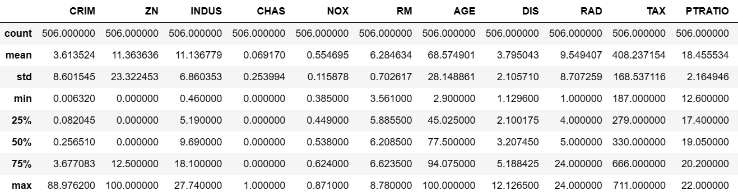
Summarize the statistics
We have calculated some statistical data such as percentile, mean and std of different numerical values for bipolar diseases.

Slide 5

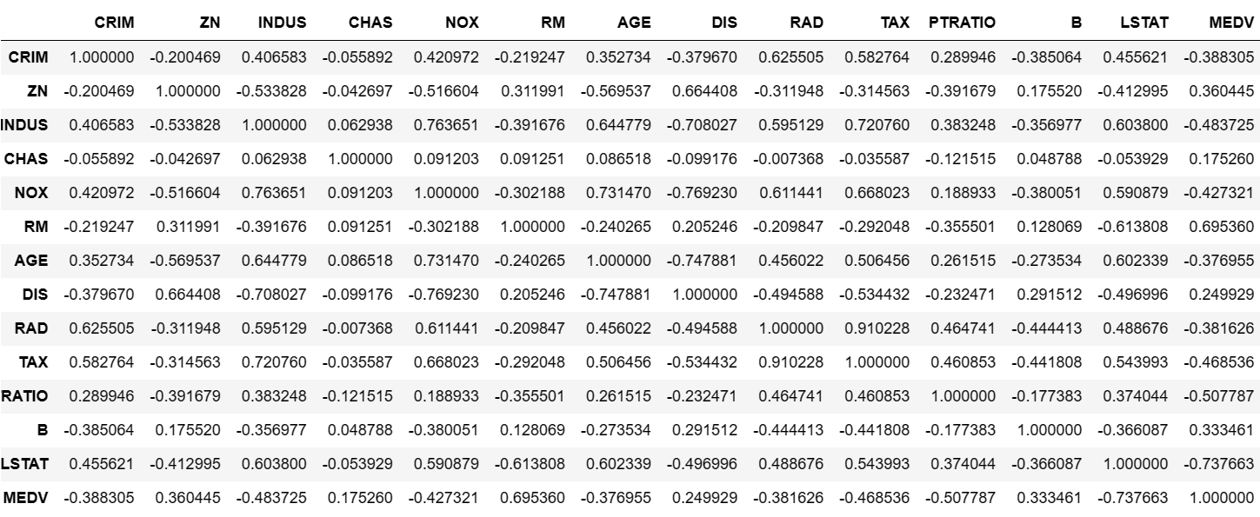
CORRELATION OF ATTRIBUTES

Slide 6
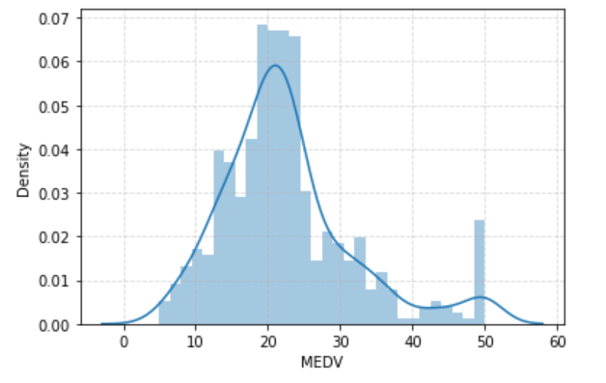
DISTRIBUTION PLOT OF MEDV
It can be inferred here that the data exhibits a central tendency with a mean value within the range of 10,000 to 50,000 USD. The range of the median house values spans from a minimum of 10,000 USD to a maximum of 50,000 USD.

Slide 7
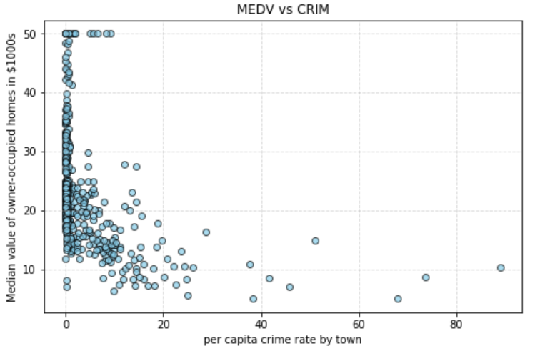
RELATIONSHIP BETWEEN PER CAPITA CRIME RATE AND HOUSING PRICE
The scatter plot indicates that neighborhoods with lower crime rates tend to exhibit higher median house values, ranging between 12,000 and 40,000 USD. Conversely, areas with higher crime rates are associated with more affordable housing, suggesting a negative correlation between crime rates and housing prices.

Slide 8
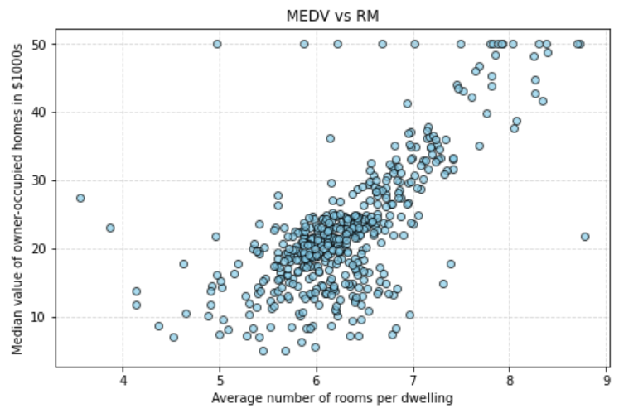
RELATIONSHIP BETWEEN AVERAGE NUMBER OF ROOMS AND HOUSING PRICE
The majority of houses in the dataset, characterized by an average of 6 to 7 rooms, are associated with median prices ranging from 20,000 to 30,000 USD. Notably, a positive correlation is observed, indicating that larger houses with more rooms tend to command higher prices.

Slide 9
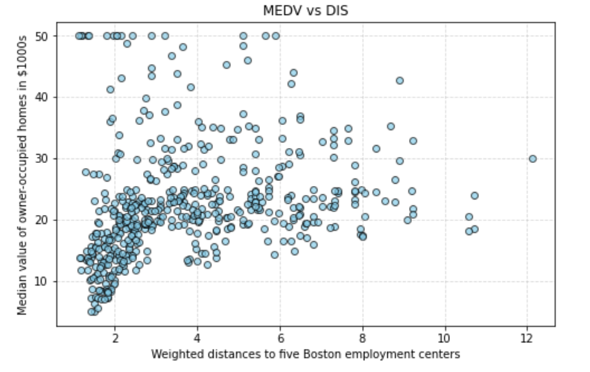
RELATIONSHIP BETWEEN WEIGHTED DISTANCES TO EMPLOYMENT CENTERS AND HOUSING PRICES
Houses with prices ranging from 5,000 to 30,000 USD exhibit a tendency to be situated in close proximity to the five employment centers, with distances typically falling within the range of 1 to 6 units. This indicates a negative correlation between distance to employment centers and housing prices.

Slide 10
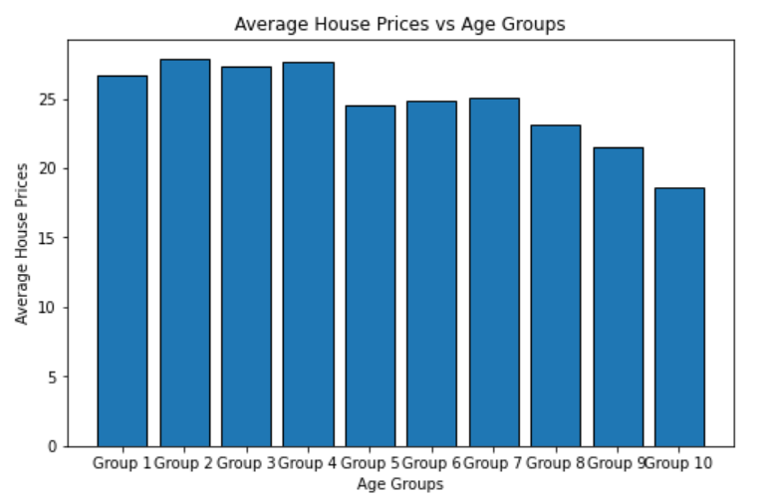
VISUALIZE OF RELATIONSHIP BETWEEN AGE GROUPS AND AVERAGE HOUSE PRICES
Houses constructed before 1940 tend to exhibit lower median prices, typically falling within the range of 10,000 to 20,000 USD. Descriptive statistics further reveal that the majority of these older houses have an age proportion between 80% and 100%.

Slide 11
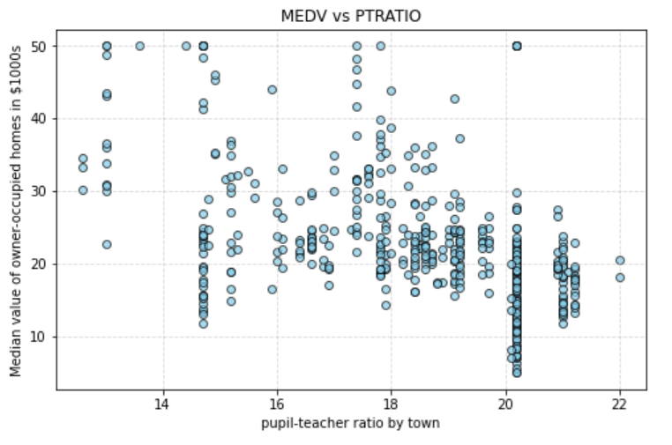
RELATIONSHIP BETWEEN PUPIL-TEACHER RATIO AND HOUSING PRICES
Houses in areas with a higher pupil-teacher ratio generally exhibit median prices ranging between 5,000 and 25,000 USD. This observation suggests a negative correlation between pupil-teacher ratios and housing prices, implying that as the pupil-teacher ratio increases, the median house values tend to decrease.

Slide 12
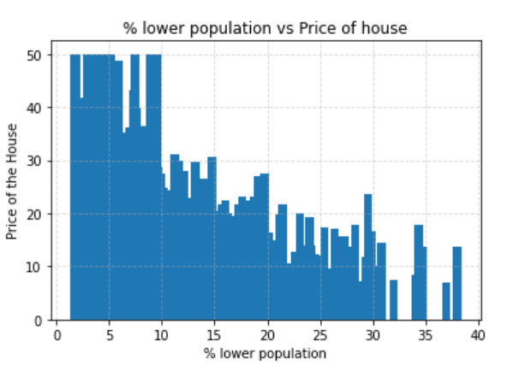
RELATIONSHIP BETWEEN THE PERCENTAGE OF LOWER STATUS POPULATION AND HOUSE PRICES
As the percentage of lower status population decreases, there is a corresponding increase in median house prices. This indicates a negative correlation between the percentage of lower status population and housing prices, suggesting that areas with a lower percentage of lower status population tend to have higher median house values.

Slide 13
LINEAR REGRESSION MODEL
LRMODEL = LINEARREGRESSION()
lrModel.fit(x_train, y_train)
TESTING ACCURACY IS: 76.37284562645749
Model accuracy is: 78.76674403820832
LINEAR REGRESSION MODEL PERFORMANCE ON TRAIN DATA :
Mean Squared Error : 18.382475396229843
Mean Absolute Error : 3.032186293179988
R2 Score : 0.7871238858414844
LINEAR REGRESSION MODEL PERFORMANCE ON TEST DATA :
Mean Squared Error : 11.31535374002142
Mean Absolute Error : 2.5651343583963975
R2 Score : 0.763728456264575

Slide 14
HYPOTHESIS TEST RESULTS
Hypothesis Test for RM :
T-statistic : 12.010163363611145, P-value : 4.2306114458476134e-29
There is a significant difference in median home values between areas with high and low average number of rooms.
Hypothesis Test for CRIM :
T-statistic: -5.841183347407717, P-value: 9.8007990758476e-09
There is a significant difference in median home values between areas with high and low crime rates.
Hypothesis Test for DIS :
T-statistic: 4.712968499584965, P-value: 3.2379517427208223e-06
There is a significant difference in median home values between areas with high and low distances to employment centers.

Slide 15
THANK YOU !!!

